Slide 1


Alcohol Education Program
For Minors
Texas Department of Licensing and Regulation

Slide 2
Course Outline
1. Social Values
2. Advertising
3. Alcohol and Young People
4. Alcohol and Accidents
5. Laws
6. Youth and Drinking Patterns
7. DECISION MAKING
2
Notes:
Topic Headings are color coordinated to Topic Unit [i.e., all slides in Social Values (Topic One) are in Dark Red].

Slide 3
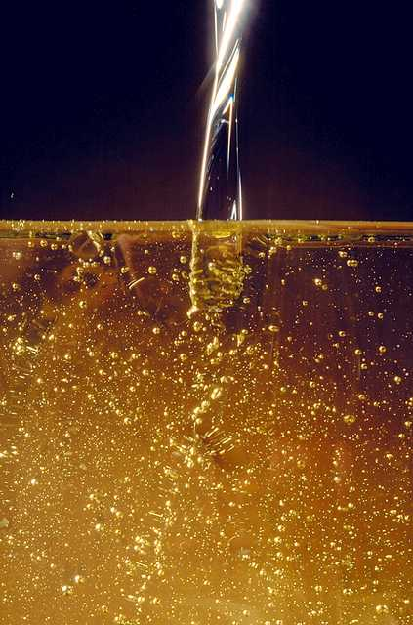
How Does Society Use The Word DRINK?
Example: “Let’s go have a DRINK.”
No thank you, I don’t DRINK.
He has a DRINKING problem.
She quit DRINKING for health reasons.
You are too young to DRINK.
3

Slide 4

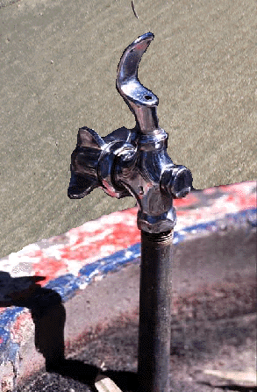
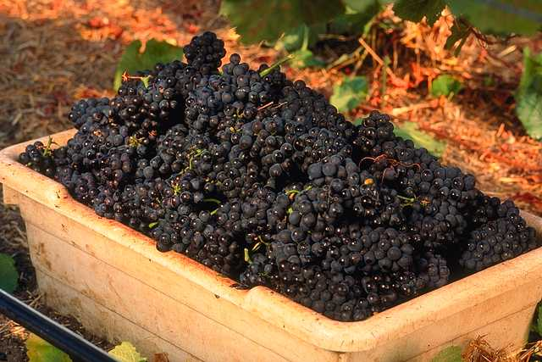

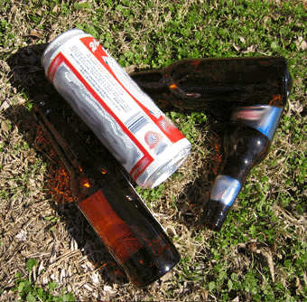

Reasons People DO Drink
Taste
Unwind
Thirst
Celebrate
Get Drunk
Peer Pressure
4

Slide 5
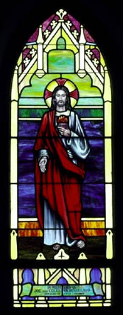
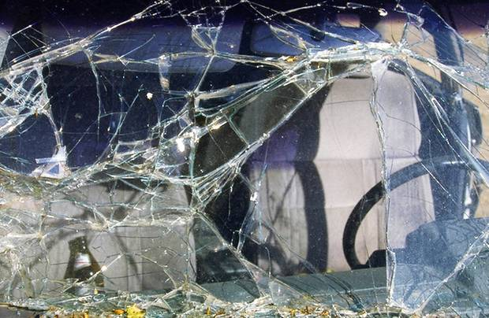
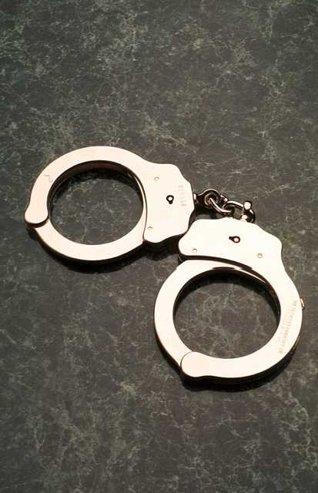
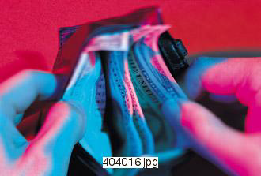
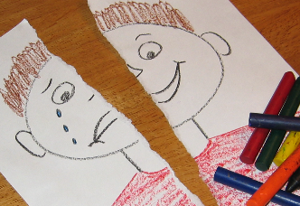
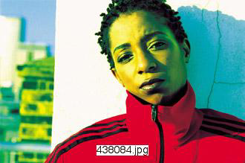
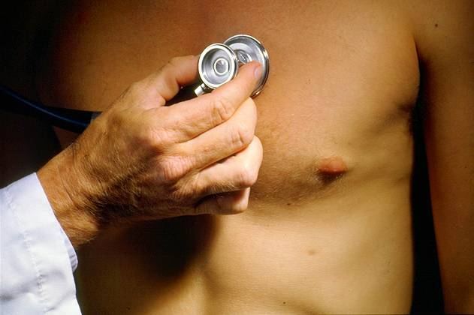
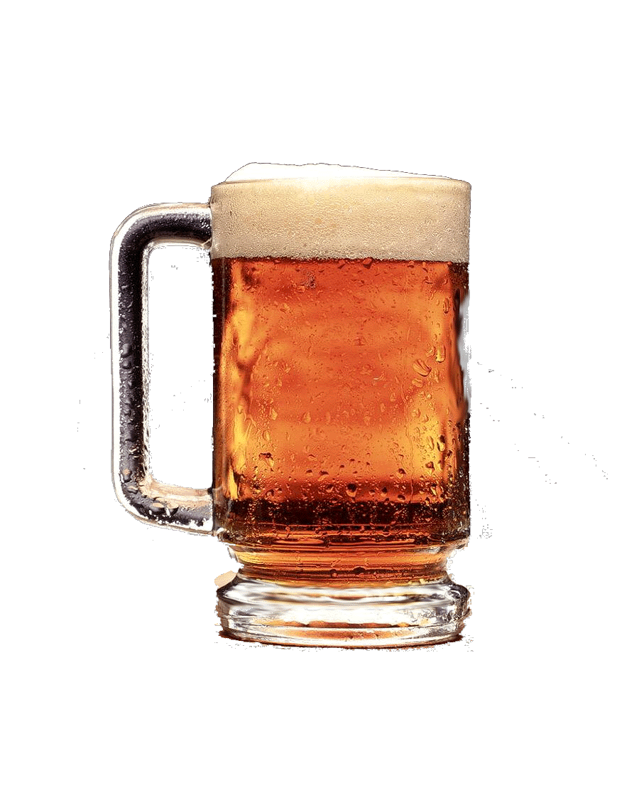
Reasons People DON’T Drink
Taste
Cost
Health
Accidents
Dislike Effects
Embarrassment
Religious Beliefs
Legal
5

Slide 6
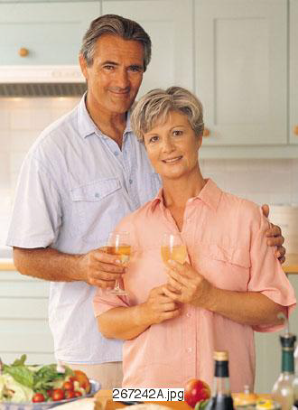
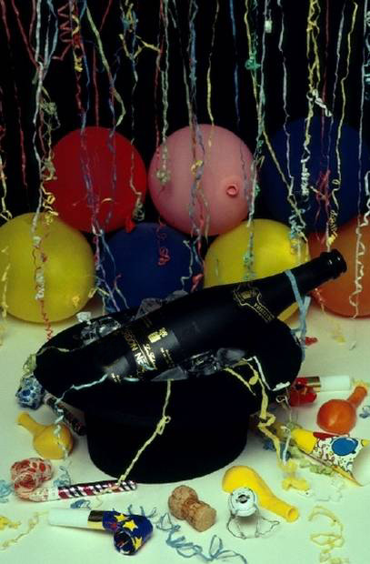
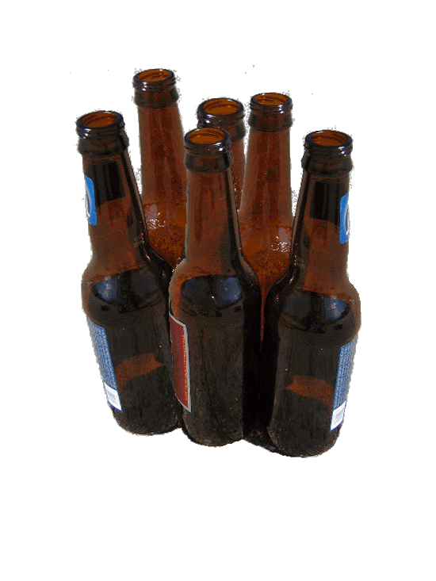
Social Standards
Permissive
At times, drunk behavior is expected.
Moderate
Alcohol is a part of life, but to get drunk is not.
Abstinent
Drinking could cause problems and the risks are not worth it.
6

Slide 7
2. Alcohol & Advertising
7

Slide 8
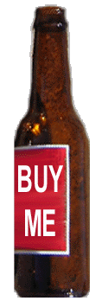
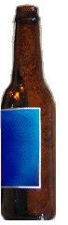

Purpose of Alcohol Advertising
Brand Identification?
Recruit New Drinkers?
Increase Consumption?
Or All Three?
8

Slide 9
Average Consumption Per Drinking Person
BEVERAGE
SIZE
CONSUMED
BEER
571 (U.S.)
12 oz. cans
747 (TX)
WINE
144 (U.S.)
4 oz. glasses
98 (TX)
DISTILLED SPIRITS
381 (U.S.)
1 oz. shots
302 (TX)
9

Slide 10

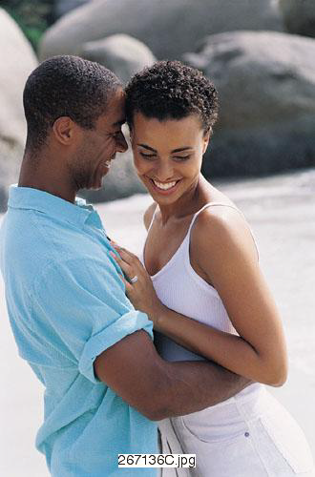

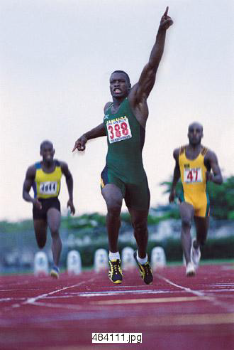
Themes In Alcohol Ads
Athletics
Success
Risky Activities
Sex
10

Slide 11
Fill In The Blank
BUDWEISER
The King of Beers .
FOSTER’S
. Australian for Beer.
MILLER
It’s Time.
Lose the Carbs. Not the Taste.
.
MICHELOB ULTRA
The National Beer of Texas
.
LONE STAR
Stay Thirsty My Friends
.
DOS EQUIS
11

Slide 12
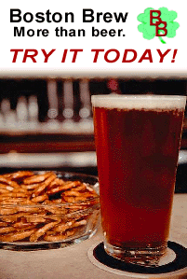
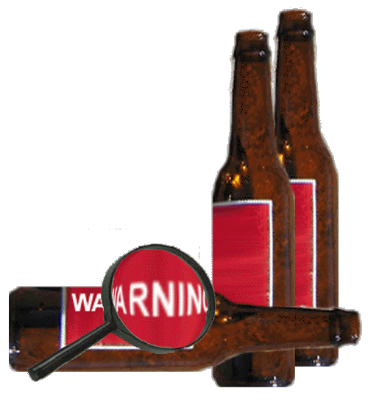
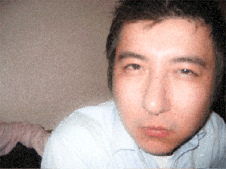
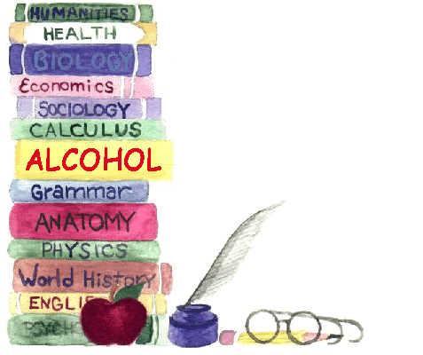
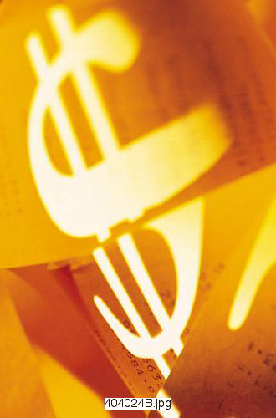

Possible Corrective Measures
Ban alcohol ads
T.A.D.D.
Warning Notices
Teens Against Drunk Driving
*
Alcohol Content
SAVE A LIFE
Be a
Designated
More accurate portrayal
Driver
BE RESPONSIBLE
DON'T DRINK
Anti-drinking ads
Under 21
Increase the tax on alcohol
No Alcohol
EDUCATION EFFORTS
12

Slide 13
3. Alcohol & Young People
13

Slide 14
Effects of Alcohol
Irritates
Sedates
14

Slide 15
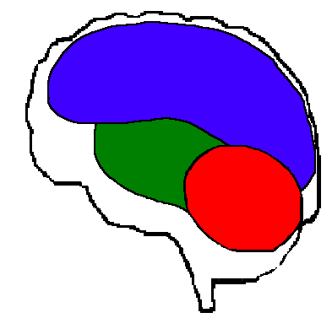
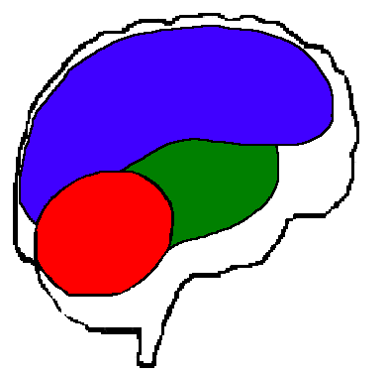
Alcohol & the Brain
Alcohol’s Sedative Effects
Mental Growth
Higher Learning Center
Higher Learning Center
Vital Functions
Muscle Control
15

Slide 16
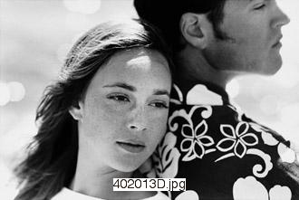
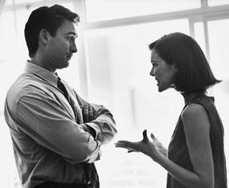
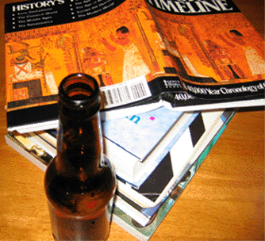
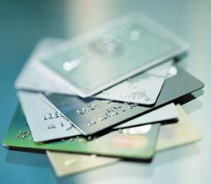
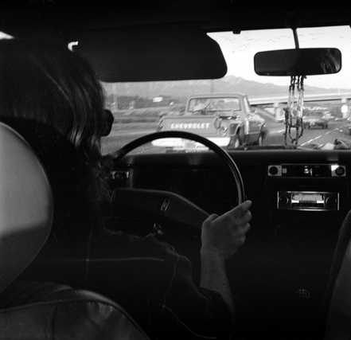
Alcohol & Decisions
Driving Too Fast/Too Slow
Engaging In Sex
Failing To Do School Work
Arguments/Fights
Spending Too Much Money
Release of Inhibitions
16

Slide 17
Alcohol & the Brain
Alcohol’s Sedative Effects
Mental Growth
Higher Learning Center
Higher Learning Center
Vital Functions
Muscle Control
Muscle Control
17

Slide 18
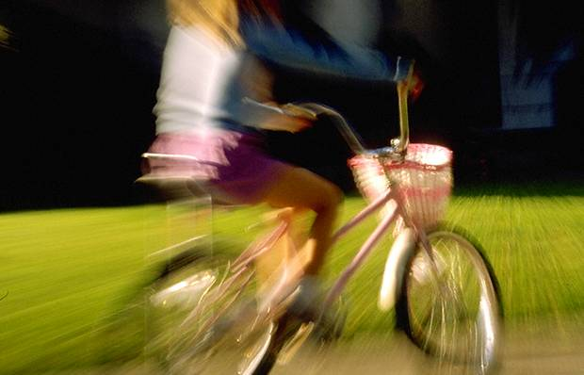
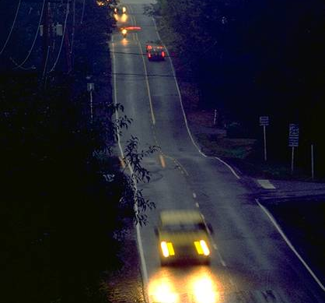
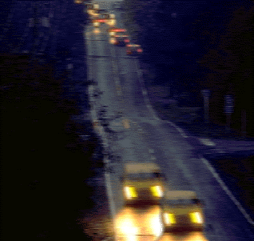

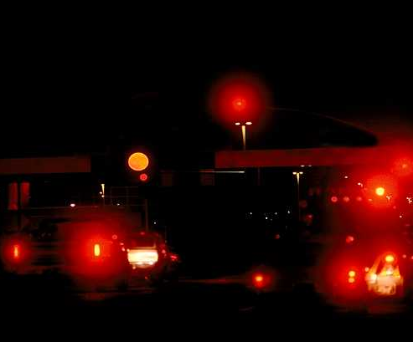
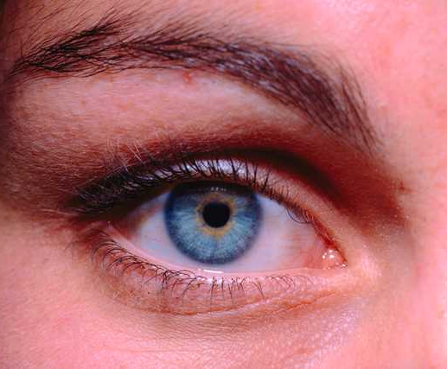
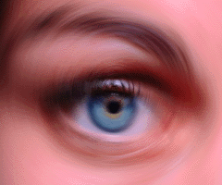
Alcohol & Vision
Eye Focus
Static
Visual Acuity
E
Side Vision
F P
Color Distinction
L P E D
Night Vision
P E C F D
Distance Judgment
E D F C Z P
Double Vision
D E F P O T E C
  Double Vision
Dynamic
18

Slide 19
Alcohol & the Brain
Alcohol’s Sedative Effects
Mental Growth
Higher Learning Center
Higher Learning Center
Vital Functions
Vital Functions
Muscle Control
Muscle Control
19

Slide 20
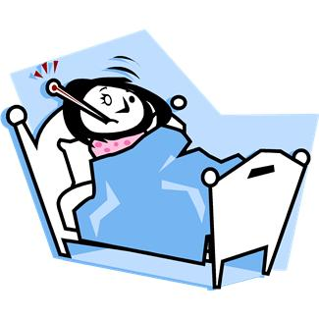
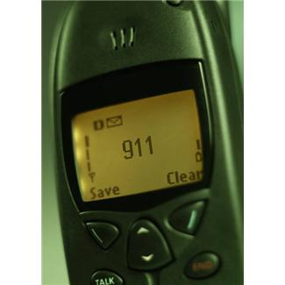
Dealing With Alcohol or Drug Overdose
Know these Signs of an Overdose:
Cannot follow directions or is unconscious
Slow or irregular breathing or making gurgling sounds
Very low or very rapid pulse rate
Vomiting while passed out
No response to shaking or pinching
Low body temperature, bluish skin color, paleness
Steps to take for overdose:
Call 911 immediately
If you are sober and near a hospital, drive person for help
Tell police or medical personnel how much the person drank or took
Turn the person on their side so they don’t choke on their vomit
Describe the symptoms you have observed to medical personnel
Things to Avoid:
Leaving person alone
Having person “walk it off”
Letting person “sleep it off”
Food or forced fluid (coffee, etc.)
20

Slide 21
Are They Equal?
Beer
Whiskey
Wine
Cooler
21

Slide 22
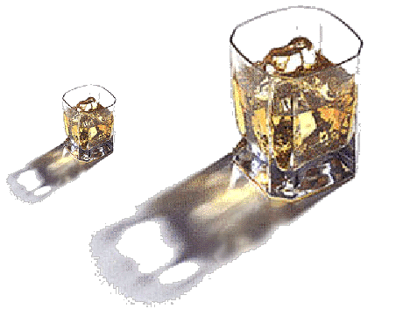
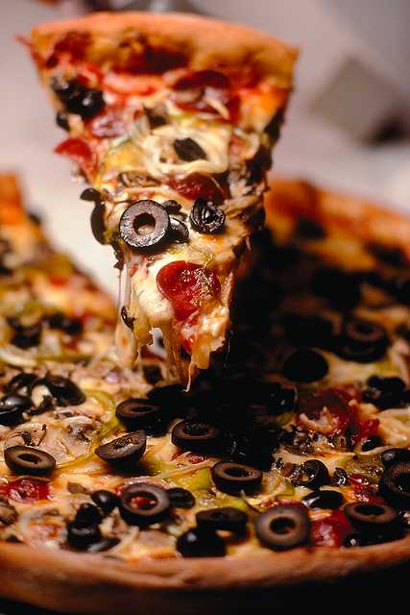
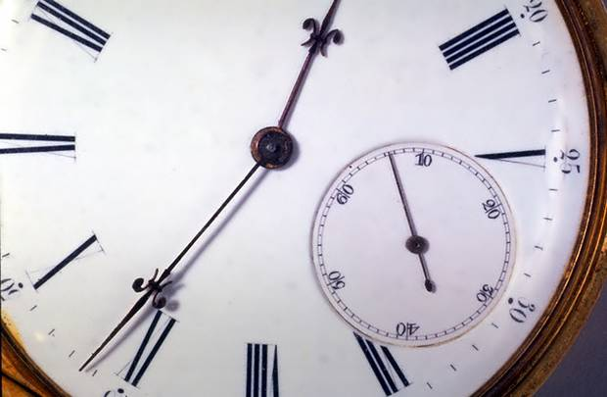
B.A.C. Factors
Body Weight / Gender
80
o
100
o
Alcohol Content of Drink
151
o
Size of Drink
Time Spent Drinking
Food
22

Slide 23
How Many Drinks = .08%?
Body Weight
# of 12 oz. Beers in 1 Hour
Blood Alcohol Concentration
220
200
Male
180
5
4
3
2
Female
160
4
3
2
1
140
120
0.08
100
When Drinking Rate Exceeds Elimination Rate, BAC Rises.
23

Slide 24
24

Slide 25
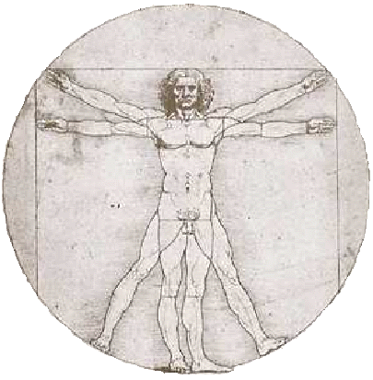
Removing Alcohol From The Body
Elimination
BREATH 8%
ABSORPTION
SWEAT 2%
LIVER 90%
Average elimination rate is .015 per hour.
25

Slide 26
Elimination Rate
BAC
STOPS
DRINKING – 1:30
.16 = PEAK – 2:00
.08 = INTOXICATED
LEGALLY – 7:30
.05 = IMPAIRED – 9:30
ABSORPTION
>
ELIMINATION
>
>
>
>
>
>
>
>
>
>
>
26

Slide 27

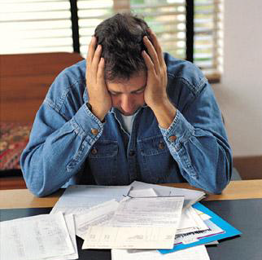
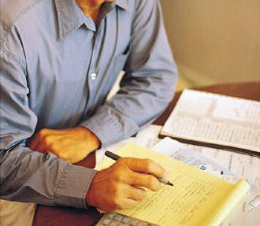
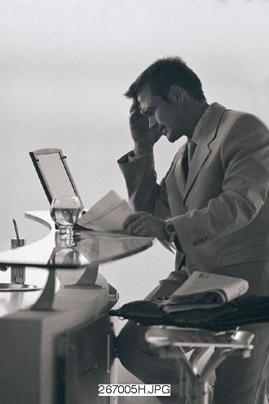
Alcohol’s Effects On Young People
Poor Scores on Vocabulary, General Information, & Memory
Reduced School Performance
Social Problems & Depression
Sleep Problems
Later Problems in Employment, Marriage, Education, & Finances
27

Slide 28
4. Alcohol & Accidents
28

Slide 29
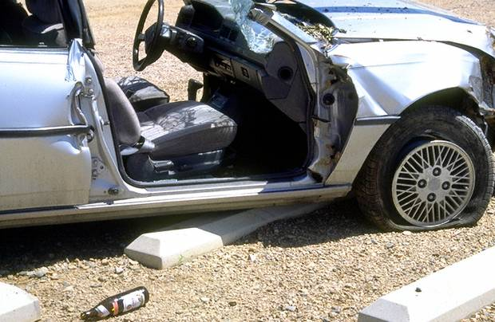
Drivers Involved in
DWI Fatalities in Texas
Age | 16-20 | 21-25 | 26-30 | 36-40 | 46-50
Licensed Drivers
DWI Drivers Involved in Fatalities
Representation
8%
16%
100% Over
10%
19%
90% Over
11%
17%
55% Over
12%
13%
8% Over
10%
6%
40% Under
29

Slide 30
BAC & Risk of Death
BAC
AGE
.020 - .049
.080 - .099
.150+
16-20
M - 5
F - 3
M - 52
F - 15
M - 15,560
F - 738
21-34
3
13
572
35+
3
11
382
Why are there gender differences for young people?
Why is age a factor?
30

Slide 31
31

Slide 32

Alcohol-Related Fatalities
After Drinking Age Raised to 21
United States
-15%
Maryland
(Zero-Tolerance)
-33%
Texas
-20%
32

Slide 33
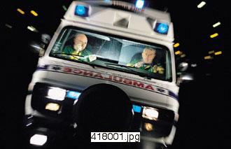
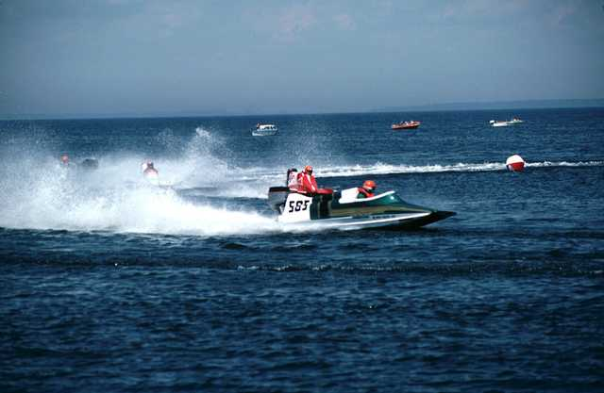
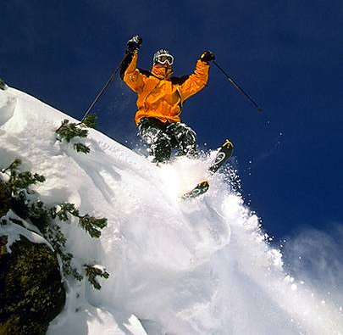





Alcohol &
Non-Traffic Accidents
Swimming
Boating
Hunting
Skiing
Home
Fire
Falls
33

Slide 34
5. Laws
34

Slide 35

Minor In Possession
Attempt to Purchase,
Purchase,
Possession,
Consumption,
Misrepresentation of Age
PENALTIES
Offense | Fine | Community Service | Loss of License | Education | Jail
1st | Up to $500 | 8-12 hours | 30 days | Required | None
2nd | Up to $500 | 20-40 hours | 60 days | Optional with judge | None
3rd or more | $250-$2000 | None | 180 days | Optional with judge | Up to 180 days
Deferred Disposition is conviction for enhancement.
No Deferred Disposition on 3rd or more.
35

Slide 36


Providing Alcohol to a Minor
Purchase for or giving alcohol to a minor is illegal unless it is the minor’s
  Adult parent
  Adult guardian
  Adult spouse
  Adult court custodian
Provider must be visibly present
Penalties
Up to $4,000 fine
Up to 1 year in jail
36

Slide 37

DUI By Minor
Unlawful to operate a motor vehicle in a public place or a watercraft with ANY detectable amount of alcohol.
PENALTIES
Offense | Fine | Community Service | Education | Jail
1st | Up to $500 | 20-40 hours | Required | None
2nd | Up to $500 | 40-60 hours | Judge’s option | None
3rd or more | $500-$2000 | 40-60 hours | Judge’s option | Up to 180 days
Deferred Disposition is conviction for enhancement.
No Deferred Disposition on 3rd or more.
37

Slide 38

Administrative License Revocation (Failed Test)
F
ARRESTED for DUI, DWI, Intoxication Assault or Intoxication Manslaughter
MINORS FAIL with ANY detectable amount of alcohol
PENALTY: LOSS OF LICENSE:
  60 days – no previous conviction
  120 days – 1 previous conviction
  180 days – 2 or more previous convictions
License taken at time of arrest
40-day temporary license issued
38

Slide 39

Implied Consent
(Refused Test)
ARRESTED while operating motor vehicle or watercraft
REFUSE breath or blood test
PENALTY: LOSS OF LICENSE
  180 days if no alcohol/drug contact in last 10 years
  2 years if one or more alcohol/drug contact in last 10 years
License taken at time of arrest
40-day temporary license issued
39

Slide 40


Definition of Intoxication
Alcohol concentration of .08% or more.
Not having normal use of mental or physical faculties
because of alcohol or other drugs.
40

Slide 41


Public Intoxication
In a public place
Intoxicated
MAY endanger self or others
PENALTIES
21 & Over | Under 21
Class C Misdemeanor: Up to $500 fine
Same as MIP
41

Slide 42

Driving While Intoxicated (D.W.I.)
Unlawful to operate a motor vehicle in a public place while intoxicated.
Offense | Fine | Loss of License | Jail
1st | Up to $2,000 | 90 days – 1 year | 72 hours – 180 days
2nd | Up to $4,000 | 180 days – 2 years | 30 days – 1 year
3rd or More | Up to $10,000 | 180 days – 2 years | 2 – 10 years
42

Slide 43

Mandatory Breath Test/Blood Draw
The taking of blood or breath is required if:
  Person is arrested for DWI AND refuses to provide a specimen AND involved in an accident where another person died or suffered serious injury
  Person is arrested for DWI with Child under age of 15
  Person is arrested for DWI AND has been previously convicted or placed on probation for DWI with Child, Intoxication Assault, Intoxication Manslaughter, OR previously convicted of 2 or more DWI’s
43

Slide 44

D.W.I. Penalties for Minors
UNDER 17
AGE 17 - 20
License loss until age 19 or 365 days, whichever is longer
Other Possible Penalties:
  Probation until age 18
  Treated as adult if certified
  Fine & Jail
Fine & Jail same as Adult
License loss = 1 year
12-hour DWI education course may be required
DWI class does not prevent license loss unless probation includes ignition interlock
44

Slide 45


Open Container
Open, seal broken or contents partially removed
Knowingly possess in passenger area
Driver or passenger
Vehicle on public highway (stopped or moving)
PENALTY: Class C Misdemeanor = Up to $500 fine
EXCEPTIONS
  Vehicle for hire
  Motor home living quarters
  Locked storage area
  Trunk
  Behind last seat if no trunk
45

Slide 46


Expungement
Reach age 21
One ABC 106 Conviction (MIP, DUI, provide alcohol)
Apply to the court in which he/she was convicted
RECORDS
46

Slide 47

Improper Use of a Drivers License
  It is illegal to possess a document with the intent of representing you are over 21. It cannot be similar to a driver’s license or personal identification unless it says NOT A GOVERNMENT DOCUMENT. A peace officer may confiscate the deceptive document.
  It is illegal to have a driver’s license that is fictitious or has been altered.
  It is illegal to lend a driver’s license to another person to use.
  It is illegal to use a driver’s license that is not your own.
  It is illegal to possess more than one currently valid driver’s license.
  In applying for an original, renewal, or duplicate license, it is illegal:
    -to provide a false name, address, or counterfeit document.
    -to knowingly make a false statement, conceal a material fact or otherwise commit fraud
47

Slide 48
6. Youth & Drinking Patterns
48

Slide 49

Stages of Alcohol Use
Experimentation
49

Slide 50

Drinking Age and Alcoholism
Start to drink before age 15 = 4 times more likely to become an alcoholic.
40% who drink before age 15 become alcohol dependent.
(10% who wait until 21)
14% decreased risk each year drinking is delayed until age 21.
50

Slide 51



Stages of Alcohol Use
Experimentation
Social Drinking
Abusive Drinking
Problem Drinking/ Alcoholism
51

Slide 52
Definition of Alcoholism
Pattern of use leading to impairment
More alcohol needed for desired affect OR less effect with same amount
Withdrawal symptoms OR drink to avoid symptoms
Desire/unsuccessful efforts to cut down
Drinking larger amounts OR for longer period of time than planned
Activities reduced/given up because of drinking
Much time spent to obtain, use, or recover
Continued use despite problems
Any 3 in 12 months reveal alcoholism.
52

Slide 53







Signs of Problem Drinking/ Alcoholism
Grade decline
REPORT CARD
Binge drinking
Extreme mood swings
Math
English
History
Biology
Art
D
C
F
F
C
Change of friends
Reduced extra-curricular activities
Irresponsibility (including $$$ problems)
Frequently depressed and guilty
Poor hygiene
53

Slide 54







Signs of Problem Drinking/ Alcoholism cont’d
Legal problems (including DWI, MIP, DUI, PI)
Poor family relations
School behavior problems
Heavy smoking/drinking
Tolerance (Increase/Decrease)
Genetics
Craving & preoccupation with alcohol
Drinking to cope
54

Slide 55








Signs of Problem Drinking/ Alcoholism cont’d
Rationalization
RATIONAL
LIES
Denial
?
?
Gulping/sneaking drinks
?
?
Difficulty in sleeping
“Not that bad yet”
Drinking alone
Leisure activities focus on alcohol
Blackouts
Delirium tremens
55

Slide 56
7. Decision Making
56

Slide 57

Decision Making
Gains ? ? ?
Losses ? ? ?
Relax
Feel High
Attract Girls/Boys
Have a Good Time
Fit In With Crowd
Forget Problems
Money
Freedom
Life
License
Health
Family or Friends
TEMPORARY
LONG-TERM
57

Slide 58

Alcohol Education Program
For Minors
©
2012 Revisions
Texas Department of State Health Services

