Slide 1
Texas Drug Offender Education Program
Department of Licensing and Regulation
Offender Education
Revised 2019

Slide 2
COURSE PURPOSE
To educate participants on the dangers of drug use, abuse and the process of behavior changes.
COURSE OBJECTIVES
To gain information on the effects of use, abuse and on personal, family, social, economic, and community life,
To identify patterns of drug use/abuse, and
To develop a plan for positive lifestyle changes.
2

Slide 3
COURSE TOPICS
A. Overview and Introduction
B. Drugs and the Body
C. Abuse and Addiction
D. Society and Drugs
E. Change
3

Slide 4
Controlled Substances Act
Schedule of Penalties & Punishment Ranges
Schedule:
II
Drug Name:
Cocaine
Penalty
Group:
I
Street Name:
Crack, Coke,
Blow
Possession
180 days - 2 yrs & $10,000 max
2 - 10 yrs. & $10,000 max
2 - 20 yrs & 10,000 max
5 - 99 yrs or life & 10,000 max
Penalty Group 1
Less than 1 g.
- State Jail Felony
1 g. but less than 4 g.
- Felony 3
4 g. but less than 200 g.
- Felony 2
200 g. but less than 400 g.
- Felony 1
4

Slide 5
DEFINITION OF
INTOXICATION IN TEXAS
Alcohol concentration of .08% or more
Not having normal use of mental or physical faculties because of alcohol or other drugs.
5

Slide 6
FINES LICENSE LOSS JAIL
DWI PENALTIES IN TEXAS
1st | Up to $2,000 | 90 days – 1 year | 72 hrs-180 days
2nd | Up to $4,000 | 180 days – 2 years | 30 days- 1 year
3rd or more | Up to $10,000 | 180 days – 2 years | 2 - 10 years
6

Slide 7

ADDITIONAL FINES ON DWI CONVICTIONS
DWI, Intoxication Assault, Intoxication Manslaughter Conviction
$3,000 for first conviction within a 36 month period
$4,500 for second or subsequent conviction within a 36 month period
$6,000 on a first or subsequent conviction if BAC was 0.15 or greater at time of test
7

Slide 8
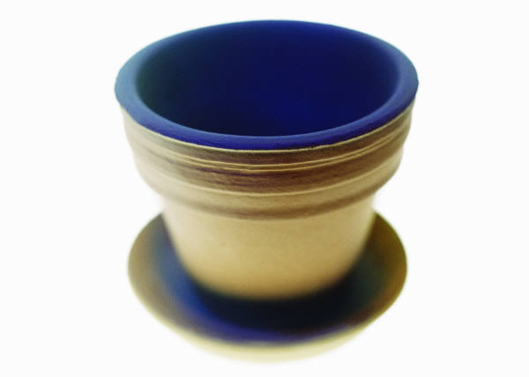
Trends in the History of Drug Use/Abuse
Stone Age:
Stone Age pots – natural fermentation
Common use of alcohol from beginning of history
Prehistoric – berry mash – airborne yeast
Euphoric effects = crude wine
8

Slide 9

4000 Years Ago
Sumerians – opium – plant of joy Greece and Cyprus, religious rituals–opium
2737 BC – Chinese knew of marijuana and its medicinal effects and its hallucinogenic effects
Ancient Greeks, Romans used poppy capsules to cure ailments
Old Testament talks of wine – story of Noah.
9

Slide 10
800 Years Ago
Aztecs, Mexican Indians – peyote, MJ and mescaline – religious rituals
South American – Incas – cocoa plant
10

Slide 11
North America, 1700-1900s
George Washington & hemp
Patent Medicines with opium – sold in grocery stores – traveling shows
Heroin could be ordered from catalogues and was marketed by Bayer
“Soldier’s Disease” – morphine
“Laughing gas” in 1800s
Hypodermic needle & pure cocaine
Opium smoking by 1875, epidemic
1884, purified cocaine – Coca-Cola
Narcotics used by mothers
Sears – injecting kits - $1.50
11

Slide 12
1920s-1950s
Smoking cannabis—came from Mexico and South America
Marijuana use increased, cocaine decreased
MJ and musicians and artists
WW II amphetamines for soldiers and pilots
Amphetamine as treatment for narcolepsy, weight, and hyperactivity
1943 LSD – Dr. Albert Hoffman

Slide 13
1960s, 1970s, 1980s
Speed and motorcycle gangs
MJ and LSD
Vietnam War and heroin
Cocaine – “Miami Vice”
Valium and tranquilizers
Designer Drugs, Ecstasy
Crack in late 1980s
13

Slide 14
1990s
Powdered meth starts to spread from Pacific coast
Crack peaks in mid 1990s
Ice comes in from Hawaii
In Texas, marijuana is most used illicit drug
Cocaine is #1 in drug treatment admissions
Alcohol is #1 over-all
Vicodin frequently abused
Rohypnol, GHB, club drugs.
Blunt cigars in Texas in 1993 changed patterns of use of marijuana
14

Slide 15
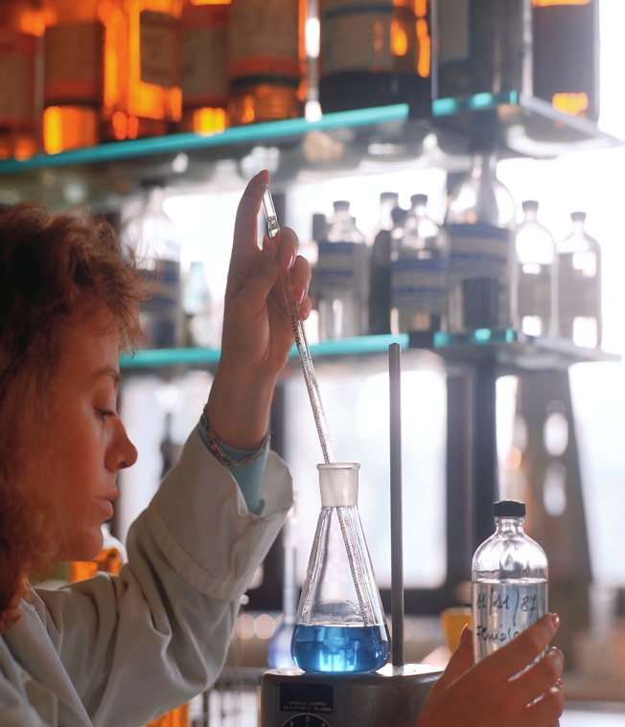
2000s
Cocaine remains a problem
OxyContin (Hillbilly Heroin)
Codeine cough syrup and rap music
Methamphetamine scene is changing with limits on pseudoephedrine
Abuse of prescription drugs is on the rise—by young and old
More potent marijuana and effects of smoking more in blunts cigars and bongs
Ecstasy use is increasing and it has moved from Raves to the street
Increasing problem with young heroin inhalers (“Cheese” heroin in Dallas but increases in inhaled heroin are statewide)
15

Slide 16
Precontemplation
(Never Thought About It)
CHANGE:
Contemplation
(Starting To Think About It)
Relapse
Preparation
(Getting Ready)
Maintenance
Action
Recovery
16

Slide 17
Think of a change in your behavior or habits that you would like to consider.
Write it down.
17

Slide 18
IMPORTANCE RULER
How important is it to you to make this change? If 0 was “not important,” and 10 was “very important,” what number would you give?
0 1 2 3 4 5 6 7 8 9 10
Write down the number.
18

Slide 19
CONFIDENCE RULER
If you decided right now to ________ , how confident do you feel about succeeding with this? If 0 was ‘not confident’ and 10 was ‘very confident’, what number would you give yourself?
0 1 2 3 4 5 6 7 8 9 10
Write down the number.
19

Slide 20
READINESS RULER
On the line below, which point best reflects how ready
you are at the present time to make the change?
Not at all
ready to ...
Thinking
about it...
Planning and
making a
commitment to...
Actively...
20

Slide 21
HIV
The virus that causes AIDS
Found in some body fluids – Blood, vaginal fluid, semen, breast milk and can be transmitted through contact with blood and other bodily fluids.
21

Slide 22
MYTHS ABOUT HIV
You don’t get it from a toilet seat, telephone, clothes, or insect bites.
You do not get HIV from hugging, coughing, sharing dishes or from casual contact. You get it from blood.
22

Slide 23
HIV TRANSMISSION
Unprotected Sex
Sharing needles/IV drug use
Possibly other drug paraphernalia if it has trace amounts of blood on it (snorting)
Mother to child during pregnancy, birth and possibly breast feeding
Receiving blood from an infected person
Razors, toothbrushes, and other personal hygiene articles that may have blood on them could carry the virus in the blood.
23

Slide 24
IMPAIRED IMMUNE SYSTEM
Impairs the immune system and the body’s ability to fight infections.
Can lead to medical conditions known as “opportunistic infections” and other serious diseases.
24

Slide 25
Progression of HIV Disease
EXPOSURE TO HIV
ONSET OF INFECTION
AIDS DIAGNOSIS
25

Slide 26
Risk Reduction
The following are possible ways that HIV can be transmitted. To reduce your risk, AVOID these activities and situations:
Sharing equipment or needles for injecting drugs
Sharing tattoo needles or piercing equipment
Using unsterile acupuncture needles
Exposure to a rash, sore or bleeding skin or gums
Unprotected sexual activity, presence of STDs, or multiple sex partners
Sexual activities that can cause bleeding
Unsafe blood transfusions and unsanitary medical care, unlikely in U.S. but a problem in some developing countries
26

Slide 27

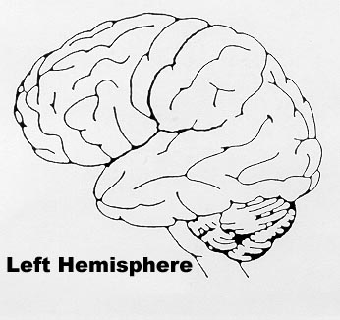
Drugs and Your Brain:
Higher Learning Center
Higher Learning Center
Vital Functions
Vital Functions
Muscle Control
Muscle Control
Progression of Drug Effects
Sequence of Mental Growth
27

Slide 28
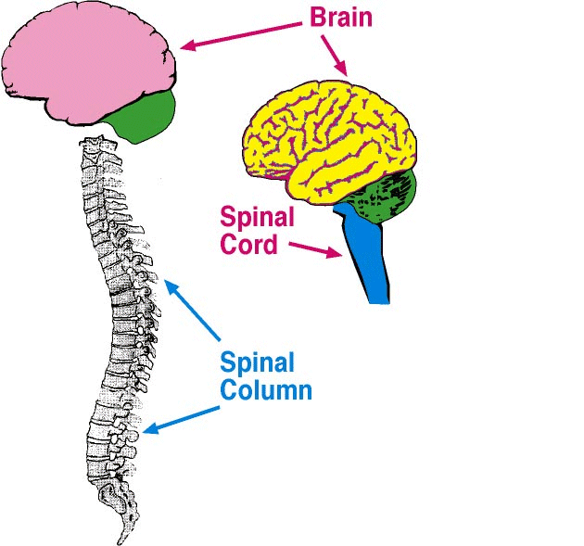
Central Nervous System
28

Slide 29
PRE-CONTEMPLATION Never Thought About It
There is no intention to change behavior.
The person is unaware or under-aware of the problem.
It isn’t that they can’t see the
SOLUTION--
It’s that they can’t see the PROBLEM.
29

Slide 30
PRE-CONTEMPLATION
The challenge is to raise doubt--
To increase the person’s perspective of risk and problems with the current behavior.
30

Slide 31
THE FIVE R’S
Reveling
Reluctance
Rebellion
Resignation
Rationalization
31

Slide 32
CONTEMPLATION
Starting to think about change.
The person is aware of the costs, but does not want to lose the benefits – thus ambivalence and conflict.
32

Slide 33
CONTEMPLATION….
Ambivalence is normal – change is hard.
Most people are ambivalent about many things much of the time.
33

Slide 34
CONTEMPLATION Starting to Think About It
The Challenge: Tip the balance
Focus on reasons to change
Explore risks of not changing
34

Slide 35
ADDICTION IS A BRAIN CHEMISTRY DISEASE
The AMA designated Alcoholism as a disease in 1955
Current Medical Thinking refers to other substances in the same light using the terms “Abuse” and “Dependence”
Everyone’s Brain is not the Same!
35

Slide 36
ADDICTION AS A DISEASE IS…
a. A Primary Problem
b. Progressive and Predictable
c. A Chronic Condition
d. Treatable, but not curable
e. Related To Genetics/Family History
36

Slide 37
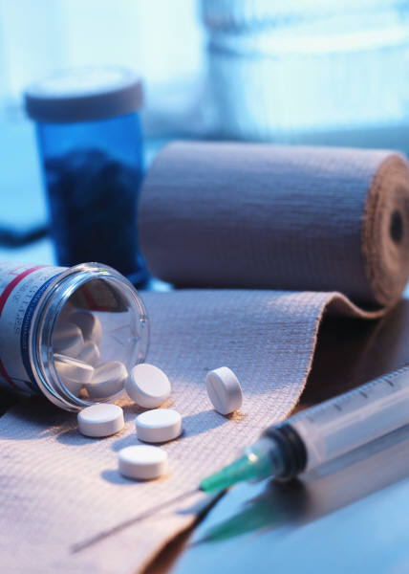
Signs & Symptoms of Dependence
Pattern of use leading to impairment
Tolerance - More of the drug needed for desired affect OR less effect with same amount
Withdrawal symptoms OR use to avoid symptoms
Desire/unsuccessful efforts to cut down
Using larger amounts OR for longer period of time than planned
Activities reduced/given up because of using
Much time spent to obtain, use, or recover
Continued use despite problems
Any 3 in 12 months reveal dependence.
37

Slide 38
Signs & Symptoms of Abuse
Pattern of use leading to impairment
Recurrent substance use resulting in problems at work, school, or home.
Recurrent use in dangerous situations.
Recurrent substance related legal problems.
Continued use despite persistent or recurrent social and relationship problems caused or made worse by drug use.
One in a 12 month period reveals abuse.
38

Slide 39
RED FLAGS
1. Continued Use Despite Adverse Consequences
2. Preoccupation
3. Family, Work, Money and Legal Problems
4. Tolerance
5. Deterioration of Relationships
6. Withdrawal
39

Slide 40
A DRUG IS A DRUG IS A DRUG
Cross Dependence/Cross Addiction
Cross Tolerance
For recovery the only way to go is complete and total abstinence from all drugs.
40

Slide 41
PREPARATION STAGE
When the balance tips, this window of opportunity may only last for a short time.
If during this time, a person enters into action, the change process continues.
If not, the person slips back into contemplation.
41

Slide 42
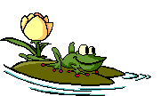
PREPARATION STAGE
The Challenge: To determine the best course of action to take in seeking change.
42

Slide 43
ACTION STAGE
What most people think of as “treatment.”
Here the person engages in particular actions designed to bring about change.
Challenge: Take steps toward change.
Normally, this takes 3-6 months to complete.
43

Slide 44
MASLOW’S HIERARCHY OF NEEDS
SELF
ACTUALIZATION
ESTEEM
LOVE/BELONGING
SAFETY
PHYSIOLOGICAL
44

Slide 45
PHYSIOLOGICAL NEEDS
Physical Needs: Food, Water, Air, Sleep, Sex, Movement or Exercise
Heart rate, blood pressure, breathing - Homeostasis
Physical Safety
45

Slide 46
SAFETY NEEDS
Finding Stability in the World
 Home, Family, Community
 Psychological Safety
46

Slide 47
LOVE AND BELONGINGNESS
Humans have a need to belong to groups
Love and Acceptance
Relationships/Significant Others
Families, tribes, teams, religious groups, clubs, gangs, etc.
47

Slide 48
ESTEEM NEEDS
Self-Esteem…
The Esteem and Recognition Attention of Others
48

Slide 49
SELF-ACTUALIZATION….
Pursuing a Path, Vocation, or Calling that Leads to Feeling Whole, Complete and Satisfied with Life.
49

Slide 50
MASLOW’S HIERARCHY OF NEEDS
SELF
ACTUALIZATION
ESTEEM
LOVE/BELONGING
SAFETY
PHYSIOLOGICAL
50

Slide 51
DRUG REPLACEMENTS
I. What needs are met through drug use?
II. What might give people some of the same benefits as drugs and yet be healthy and productive?
III. What skills, abilities, resources might people need to develop to get those benefits?
51

Slide 52
MAINTENANCE
Maintenance is the continuation
not the absence of change.
52

Slide 53
RECOVERY….
The Challenge:
Strengthen the habits of recovery;
Support the efforts at living the new lifestyle;
Be prepared no matter what!
53

Slide 54

RELAPSE A return to the problem behavior.
If relapse occurs, the task is to:
Start around the wheel again;
Don’t get stuck in this stage.
54

Slide 55
Definitions
Values
Basic beliefs about what is valuable or worthwhile. Values guide our behavior. They are the rules by which we live.
Attitudes
They express our position on situations, people and ideas - whether negative or positive.
Behaviors
Behaviors are our actions - How we act.
55

Slide 56
THE IMPORTANCE OF VALUES
If our value systems are different from those who make the laws, we will get into conflict.
If we behave in a way that is out of line with our values, we get into difficulties.
Our values lay the foundation for our behavior in everything we do.
Values determine how we see ourselves, how we relate to others, the goals we set, how we spend our time, and how we live.
56

Slide 57
RESOURCES
Support Groups
Outpatient Treatment
Inpatient Treatment
Other Support Organizations
57

Slide 58
Precontemplation
(Never Thought About It)
CHANGE:
Contemplation
(Starting To Think About It)
Relapse
Preparation
(Getting Ready)
Maintenance
Action
Recovery
58

Slide 59
DEFINITION OF RECOVERY
Recovery is a growth process that brings about a lifestyle change. It is a lengthy journey, and like all change, it does not happen all at once.
It is a continuous process which leads to an overall improvement, although there may be some setbacks along the way.
Recovery requires that we deal with the needs that drug use and associated illegal activities were supposed to fill.
59

Slide 60
STEPS IN RECOVERY
ABSTINENCE:
not using drugs
SOBRIETY:
Learning how to cope with life without drugs
COMFORTABLE LIVING:
Learning how to live comfortably while remaining abstinent
PRODUCTIVE LIVING:
Learning how to build a meaningful, sober lifestyle
60

Slide 61
DEFINITION OF RELAPSE
Relapses are setbacks or returning to old behaviors that may or may not lead to using drugs.
Relapse begins long before the drug is taken.
It starts when a person stops dealing with problems, stops getting support, or gets into risky situations.
Taking the drug is actually the end of relapse, not the beginning.
61

Slide 62
Warning Signs of Relapse:
Exhaustion
Dishonesty
Impatience
Frequent negative moods and emotional overreactions
Self-Pity
Complacency
Isolation
Avoiding Problems
Hopelessness
Omnipotence
62

Slide 63
WHY PLANNING?
Breaks the future into smaller steps
Gives a sense of order
Helps you decide which problems need attention
Combats passivity
Creates ownership
Keeps you on track -- dealing with the real problems
63

Slide 64
SAMPLE ACTION PLAN
1. Step #1 - IDENTIFY THE CHANGE:
Example: “Sally has been using drugs for 14 years and wants to stop.”
2. Step #2 - LONG - RANGE GOAL:
Example: “Sally will be drug free and content in recovery.”
64

Slide 65
3. Step #3 - FORCES FOR AND AGAINST:
Example: Desire to stay clean and sober.
Against: Concerns about her children, health, and finances.
Long standing history of drug use. Lack of social support and friends in recovery. Not knowing how to stay clean.
4. Step #4 - SHORT-RANGE GOAL:
Example: To stop using drugs (to get clean).
5. Step #5 - ACTIVITIES/ACTIONS:
Example: Attend detox if needed. Begin attending NA or other support. Get a sponsor.
65

Slide 66
6. Step #6 - GETTING HELP:
Example: Call a sponsor who will provide advice and encouragement. Ask for assistance in exploring available counseling programs for herself.
7. Step #7 - BACK-UP PLAN:
Example: Increase involvement in NA/AA to help maintain recovery. Increase level of treatment.
8. Step #8 - THE NEXT STEP:
Example: Continue aftercare and Family Counseling. Continue AA/NA or other recovery support.
66

Slide 67
BARRIERS
Procrastination
Resentments
Impulsiveness
Indecision
Hopelessness
Alcohol/drug use
Fear
Minor set-backs
Lack of commitment
67

