Slide 1


Texas DWI
Education Program
Texas Department of
Licensing and Regulation
1

Slide 2
2

Slide 3

COURSE OBJECTIVE
To have people carry out responsible drinking/drugged driving decisions which will prevent future DWI behavior.
COURSE PURPOSES
1. Gain information about the effects of alcohol and drugs on driving skills.
2. Identify your own drinking or drugged driving pattern.
3. Develop a plan to reduce the chance that you will be involved in future DWI behavior.
3

Slide 4
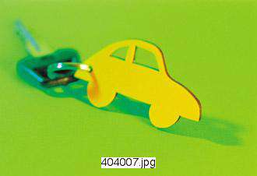
TRAFFIC DEATHS & ALCOHOL
Number of traffic deaths in 2017…
US?
Texas?
Have traffic related deaths increased or decreased since 2009?
What percent of traffic deaths involve alcohol?
Have alcohol-related traffic deaths increased or decreased since 2009?
4

Slide 5
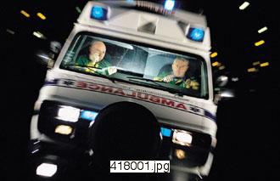
TRAFFIC DEATHS 2017
U.S. – 37,133 Texas – 3,639
TRENDS IN TRAFFIC DEATHS
YEAR | US | TX
2009 | 33,808 | 3,071
2017 | 37,133 | 3,639
 | Up 10% | Up 18%
5

Slide 6
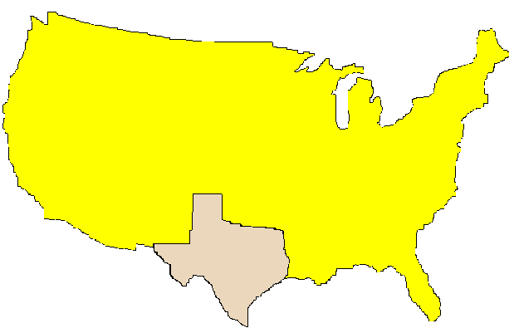
ALCOHOL RELATED TRAFFIC DEATHS OF ALL TRAFFIC DEATHS: 2017
29%
28%
2009-2017 TREND
US – Decrease 9%
Texas – Decrease 19%
6

Slide 7
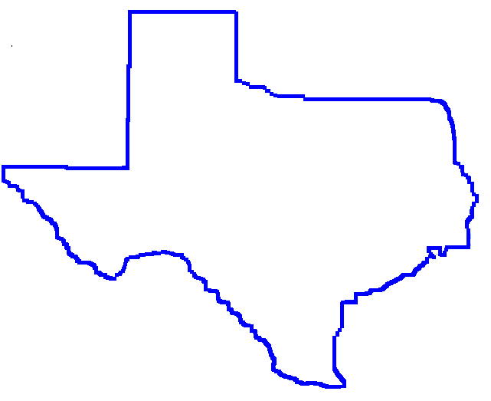
POSSIBLE REASONS FOR DECLINE IN PERCENTAGE OF ALCOHOL-RELATED DEATHS IN TEXAS
More enforcement?
Stronger Laws?
Lower BAC level used?
More breath tests given?
Education?
Safer vehicles?
Other factors?
7

Slide 8
8

Slide 9
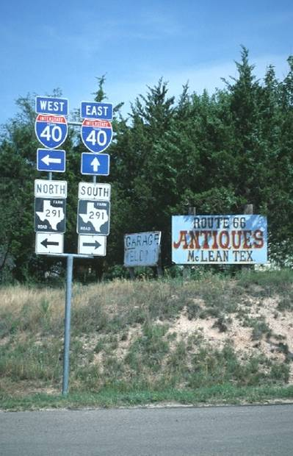
DEFINITION OF INTOXICATION IN TEXAS
Alcohol concentration of .08 or more.
Not having normal use of mental or physical faculties
because of alcohol or other drugs.
9

Slide 10
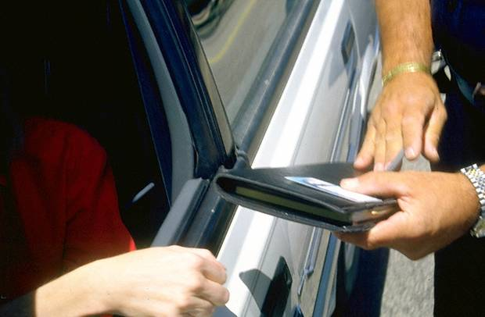

ADMINISTRATIVE LICENSE REVOCATION (ALR)
(FAILED TEST)
ARRESTED for DWI, Intoxication Assault, or Intoxication Manslaughter
Test is taken and failed (.08 or greater)
Adult Penalty – Loss of license
90 days if no alcohol/drug contacts in last ten years
1 year if one or more alcohol/drug contacts in last ten years
Officer takes possession of license
Temporary license for 40 days
$125 reinstatement fee
10

Slide 11
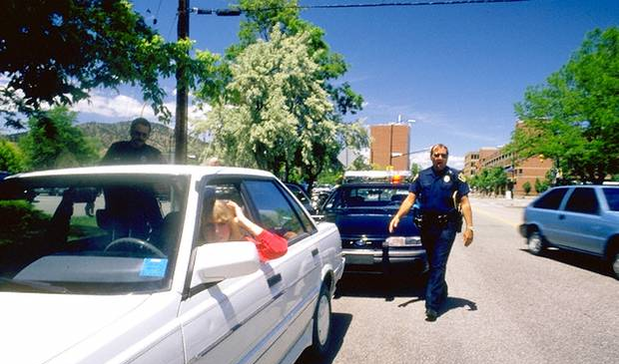
IMPLIED CONSENT LAW (REFUSED TEST)
Arrested operating motor vehicle or a watercraft
Refuse breath or blood test
Adult Penalty - Loss of license
180 days if no alcohol/drug contact in last ten years
Two years if one or more alcohol/drug contacts in last 10 years
License taken at time of arrest and 40 day temporary license issued
$125 reinstatement fee
11

Slide 12
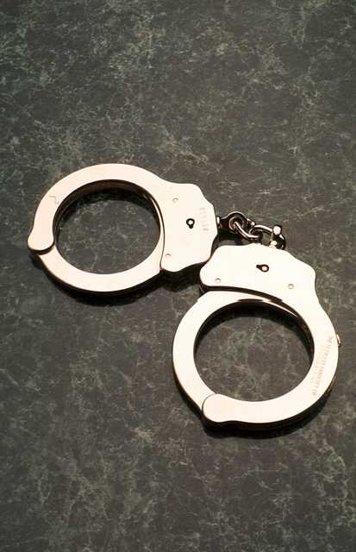
DWI PENALTIES IN TEXAS
FINES
LICENSE LOST
JAIL
1st
Up to $2,000
90 days – 1 year
72 hours –
180 days
2nd
Up to $4,000
180 days –
2 years
30 days –
1 year
3rd+
Up to $10,000
180 days –
2 years
2 – 10 years
12

Slide 13

ADDITIONAL FINES ON DWI CONVICTIONS
DWI, Intoxication Assault, Intoxication Manslaughter Conviction
$3,000 for first conviction within a 36 month period
$4,500 for second or subsequent conviction within a 36 month period
$6,000 on a first or subsequent conviction if BAC was 0.15 or greater at time of test
13a

Slide 14
Changes to the Law Requiring Taking Breath or Blood
The taking of breath or blood is required if:
Person is arrested for DWI AND refuses to provide a specimen AND involved in an accident where another person died or suffered serious injury
Person is arrested for DWI with Child under age of 15
Person is arrested for DWI AND has been previously convicted or placed on probation for DWI with Child, Intoxication Assault, Intoxication Manslaughter OR previously convicted of 2 or more DWI’s
13b

Slide 15
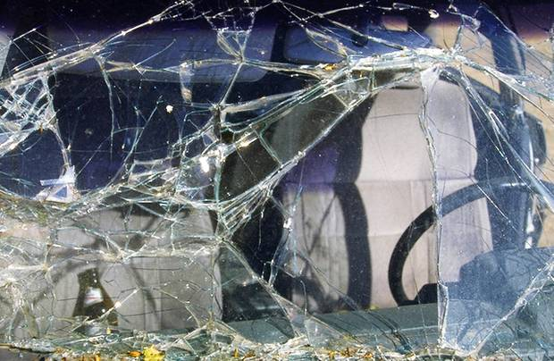
Enhancement
If peace officer, firefighter, or EMS personnel is seriously injured or killed.
Serious bodily injury - 2nd degree felony, 2-20 years in prison, up to $10,000 fine.
Killed - 1st degree felony, 5-99 years/life in prison, and up to $10,000 fine.
If Intoxicated Assault resulting in traumatic brain injury- 2nd degree felony, 2-20 years in prison, up to $10,000 fine.
13c

Slide 16
OPEN CONTAINER LAW
Vehicle on public highway (stopped or moving)
Driver or passenger
Knowingly possess in passenger area
Open, seal broken, or contents partially removed
Penalty - Class C misdemeanor - up to $500 fine
EXCEPTIONS:
Vehicle for hire - passenger area
Motor home living quarters
Locked storage area
Trunk
Behind last seat if no trunk
14

Slide 17

DWI EDUCATION COURSE MODULES
A - Alcohol / Drug Traffic Safety Problem
B - Effects of Alcohol / Drugs on the Driving Task
C - Alcohol / Drug Abuse & Dependency
D - Personal Action to Avoid Future DWI Behavior
15

Slide 18
16

Slide 19

True or False?
?
?
?
?
Alcohol is a stimulant
?
All drugs are depressants
?
Alcohol/drugs decrease
mental and physical abilities
?
?
There are ways to sober up quickly
Alcohol/drugs affect individuals differently
?
?
17

Slide 20


WHICH HAS MORE ALCOHOL?
Beer - 12 oz.
Wine - 4 oz.
Whiskey - 1 oz.
Cooler - 12 oz.
18

Slide 21
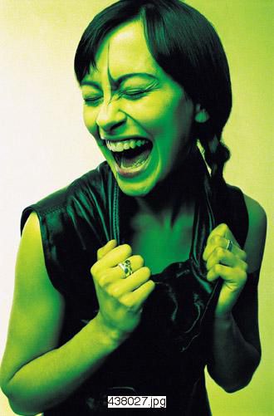

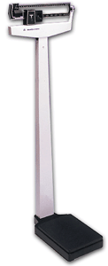
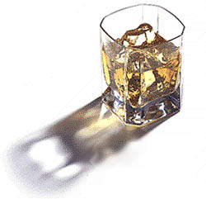
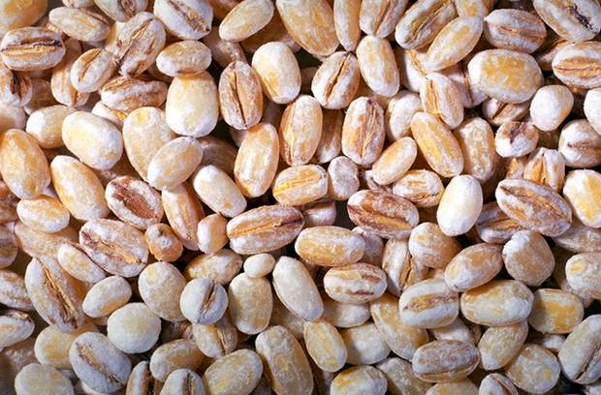
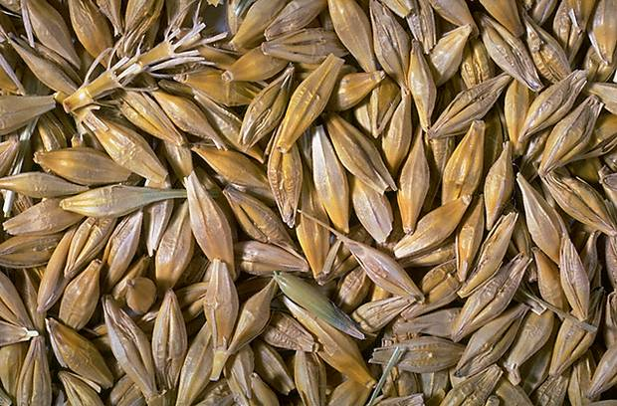

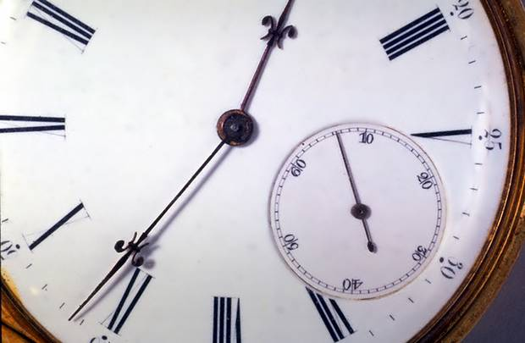

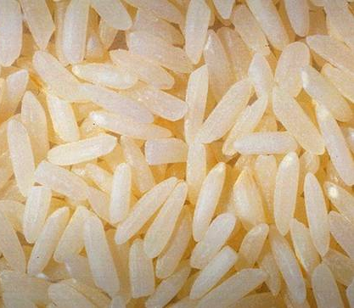
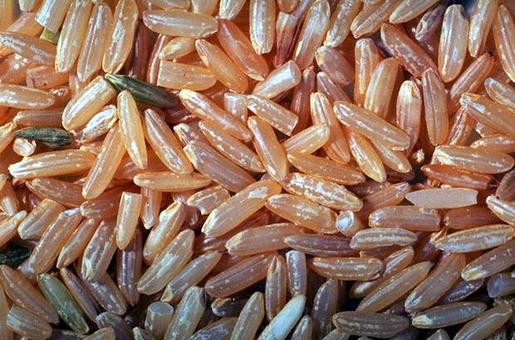
BLOOD ALCOHOL CONCENTRATION FACTORS
Rate of Absorption
Strength
80
o
100
o
Food
Carbonation
151
o
Other ingredients
Emotions
Male/Female Differences
Drinking Rate
Body Weight
Size of Drink
19

Slide 22


HOW MANY DRINKS = .08?
BODY WEIGHT (LBS)
# OF 12 OZ. BEERS IN ONE HOUR
BLOOD ALCOHOL CONCENTRATION
220
200
180
5
4
3
2
160
4
3
2
1
140
120
0.08
100
When Drinking Rate Exceeds Elimination Rate, BAC Rises.
20

Slide 23
21

Slide 24
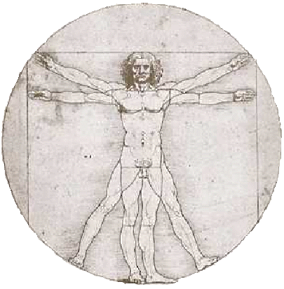
REMOVING ALCOHOL FROM THE BODY
Elimination
BREATH 8%
ABSORPTION
SWEAT 2%
LIVER 90%
BAC is lowered about .015% per hour.
22

Slide 25
ELIMINATION RATE
BAC
STOPS
DRINKING – 1:30
.16 = PEAK – 2:00
.08 = INTOXICATED
LEGALLY – 7:30
.05 = IMPAIRED – 9:30
ABSORPTION
>
ELIMINATION
>
>
>
>
>
>
>
>
>
>
>
23

Slide 26
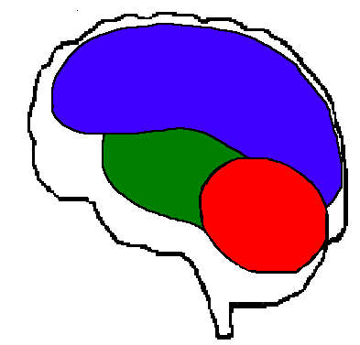
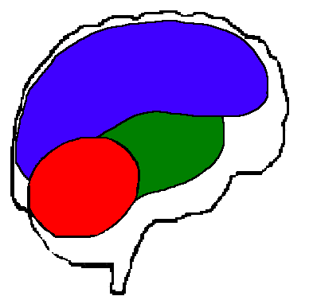
ALCOHOL & YOUR BRAIN
Sequence of
Mental Growth
Progression of Alcohol’s Sedative Effects
Higher Learning Center
Higher Learning Center
Vital Functions
Vital Functions
Muscle Control
Muscle Control
24

Slide 27
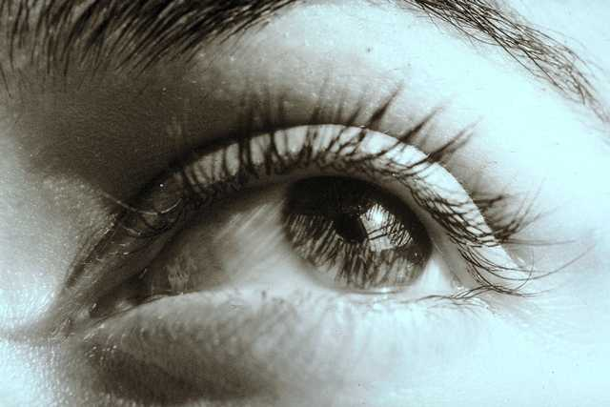
HOW ALCOHOL AFFECTS VISION
visual acuity
night vision
side vision
color distinction
glare recovery
distance judgment
eye focus
double vision
double vision
25

Slide 28

SHORT-TERM EFFECTS OF ALCOHOL
Perception
Emotions
Motor ability
Heart
Sleep
Hangover
26

Slide 29
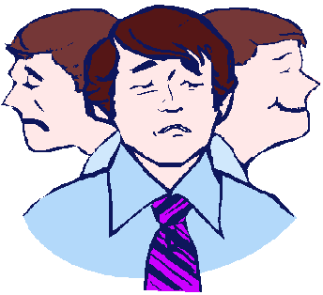
REASONS FOR DIFFERING EFFECTS OF ALCOHOL
Expectations
Mood
Tolerance
Fatigue
Individual Differences
27

Slide 30
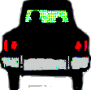
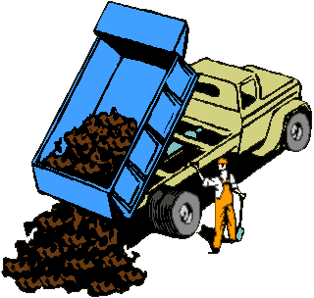
I.P.D.E.
28

Slide 31
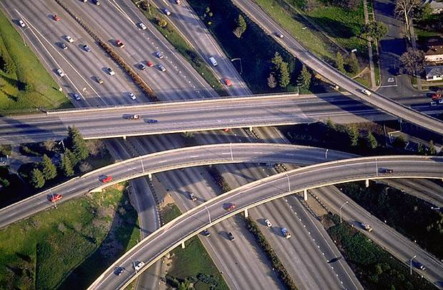

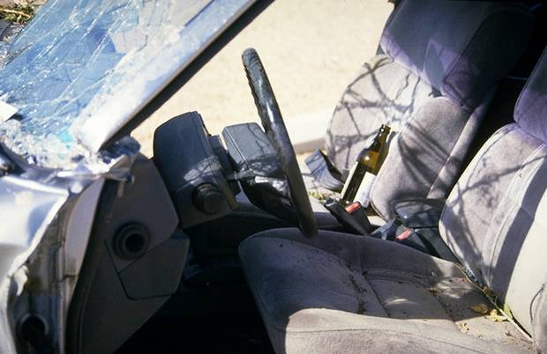
SUMMARY OF EFFECTS
Human Effects:
Brain
Vision
Perception
Driving Related Factors:
IPDE, Attention, Tracking, Risk, Reaction Time, Actual Driving Tests
Risk Factors:
Fatal Crash Involvement
Crash Responsibility
Driver Death
29

Slide 32
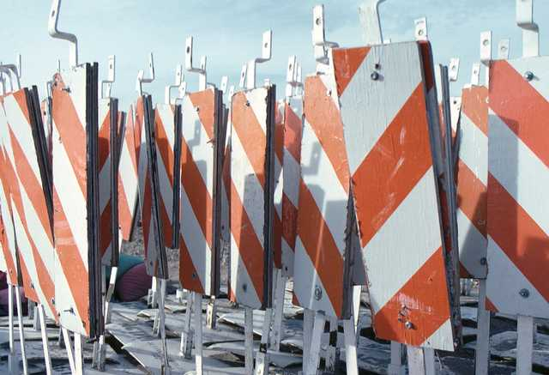
DRIVING TASK EFFECTS & BAC
BAC
.02
.04
.06
.08
.10
.12
TASK AFFECTED:
Divided Attention
BAC
.02
.04
.06
.08
.10
.12
30

Slide 33
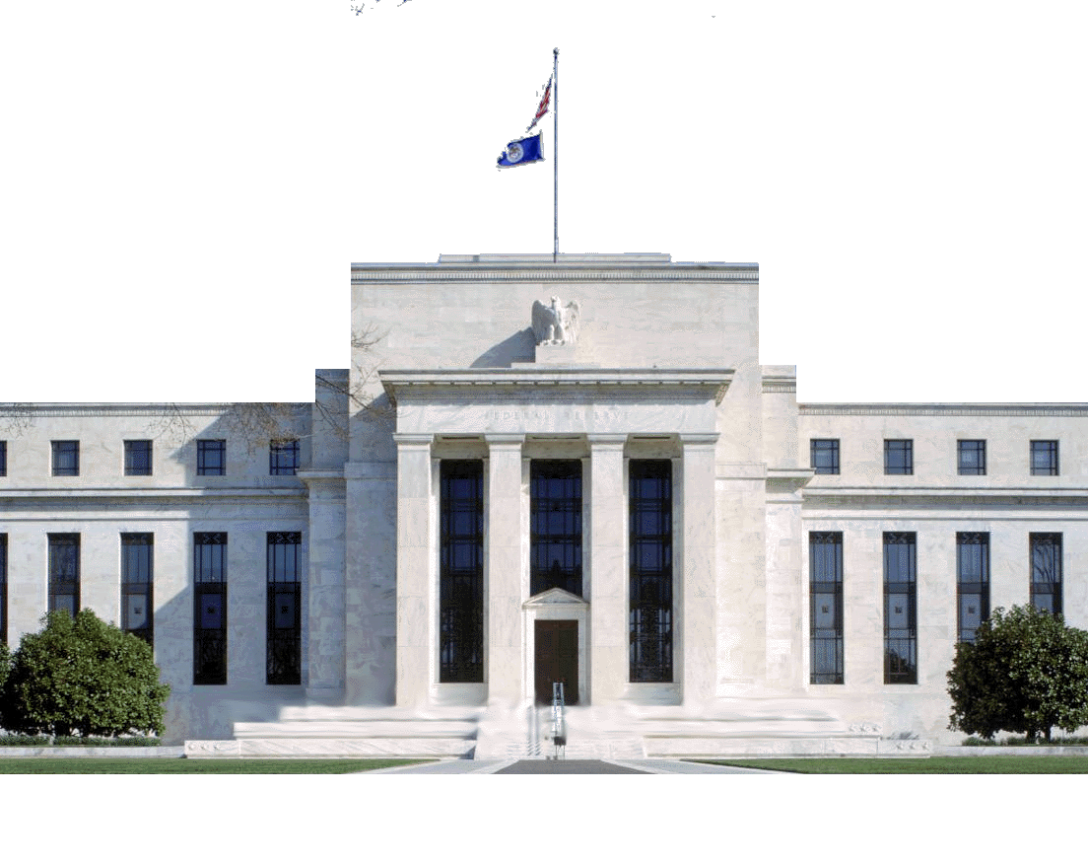


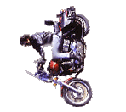
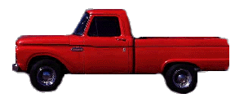


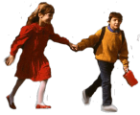
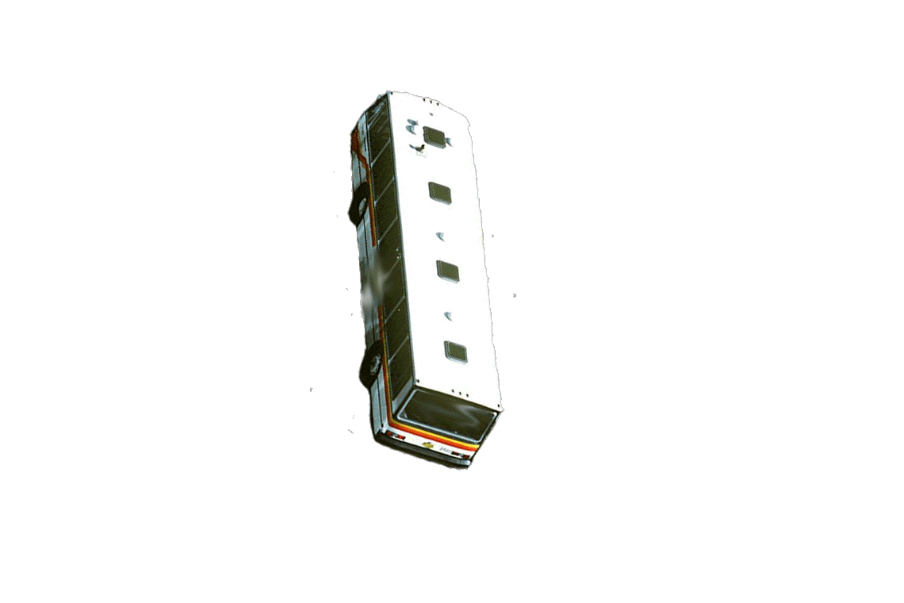

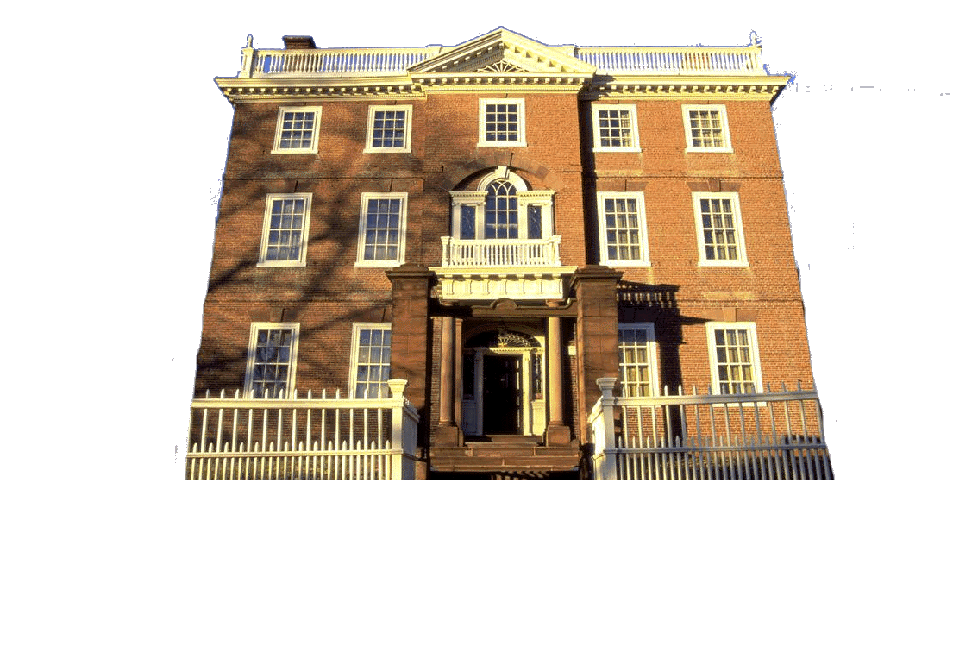
D
E
A
C
F
B
31

Slide 34
DRIVING TASK EFFECTS & BAC
BAC
.02
.04
.06
.08
.10
.12
TASK AFFECTED:
Divided Attention
Information Processing
BAC
.02
.04
.06
.08
.10
.12
32

Slide 35
NO PASSING ZONE
33

Slide 36
DRIVING TASK EFFECTS & BAC
BAC
.02
.04
.06
.08
.10
.12
TASK AFFECTED:
Divided Attention
Information Processing
Tracking and Steering
Perception
BAC
.02
.04
.06
.08
.10
.12
34

Slide 37


PERCEPTION
A
B
35

Slide 38
DRIVING TASK EFFECTS & BAC
BAC
.02
.04
.06
.08
.10
.12
TASK AFFECTED:
Divided Attention
Information Processing
Tracking and Steering
Perception
Reaction Time
BAC
.02
.04
.06
.08
.10
.12
36

Slide 39

REACTION & BRAKING DISTANCES
Reaction distance + Braking distance = Stopping distance
BAC
20 MPH
40 MPH
60 MPH
Reaction Increase %
.00% | 22+20 = 42 ft | 44+73 = 117 ft | 66+184 = 250 ft | NONE
.05% | 29+20 = 49 ft | 58+73 = 131 ft | 87+184 = 271 ft | +32%
.10% | 31+20 = 51 ft | 62+73 = 135 ft | 93+184 = 277 ft | +41%
37

Slide 40
38

Slide 41
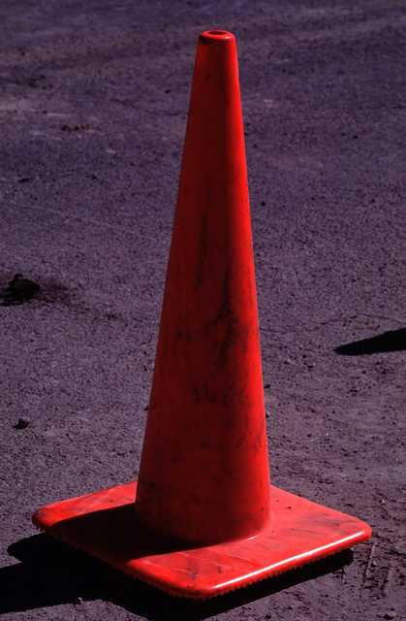
EFFECTS OF ALCOHOL ON DRIVING ABILITY
EXERCISE
.04
.07
.10
Skid,
Crash Simulator,
Auto Control
-13%
-17%
-24%
Blocked Lane,
Slalom, T-Turn
-2%
-3%
-8%
Control Group - Unchanged
39

Slide 42
RISK OF DEATH AFTER DRINKING
AGE
BAC
.020 - .049
.080 - .099
.150+
16-20
21-34
35+
M – 5 F – 3
3
3
M – 52 F – 15
13
11
M– 15,560 F– 738
572
382
Why are there gender differences for young people?
Why is age a factor?
40

Slide 43
SURVIVAL RISK & BAC
BAC | Increased Chance of Death Compared to Sober Drivers *
.03 | 1.2
.07 | 1.5
.12 | 2.4
.17 | 2.5
.22 | 3.7
* Given a crash has occurred
41

Slide 44
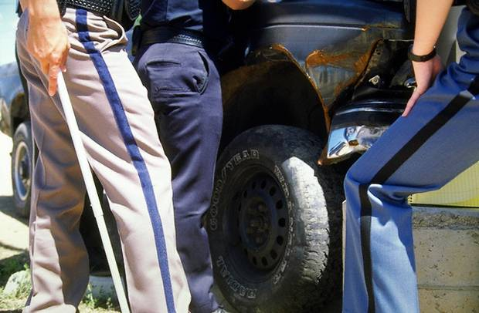
BAC & CRASH RESPONSIBILITY
BAC | % Responsible for Crash
.01 - .05 | 64%
.05 - .079 | 88%
.08 - .149 | 92%
.15 and greater | 96%
42

Slide 45
SUMMARY OF EFFECTS
Human Effects:
Brain
Vision
Perception
Driving Related Factors:
IPDE, Attention, Tracking, Risk, Reaction Time, Actual Driving Tests
Risk Factors:
Fatal Crash Involvement
Crash Responsibility
Driver Death
43

Slide 46
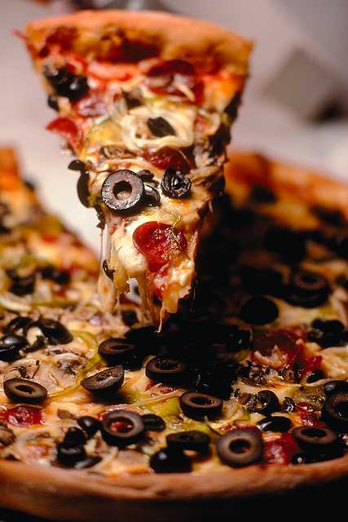
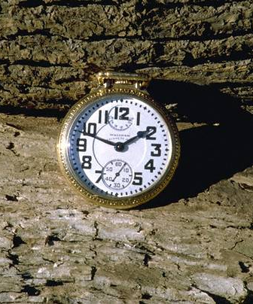
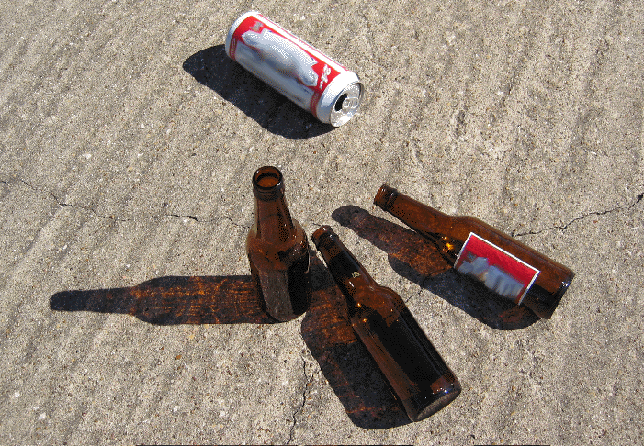
PREVENTING INTOXICATION
Food
Time
Strength
Amount
80
o
100
o
151
o
44

Slide 47
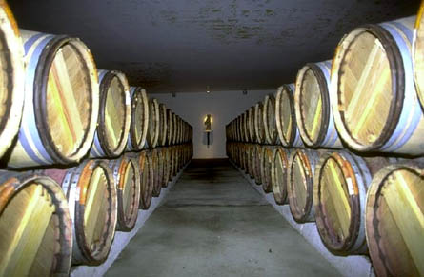
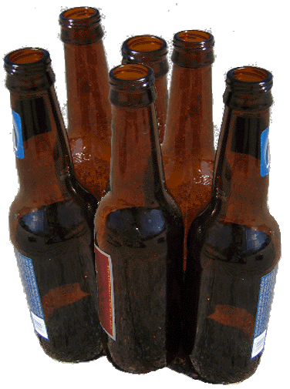
YOU KNOW YOU’VE HAD TOO MUCH IF...
IF
someone asks
to drive you
home
IF
you can’t
remember how much
you’ve had
IF
routine things
surprise you
IF
fine motor skills become difficult
IF
you seem to be the only one drinking
45

Slide 48
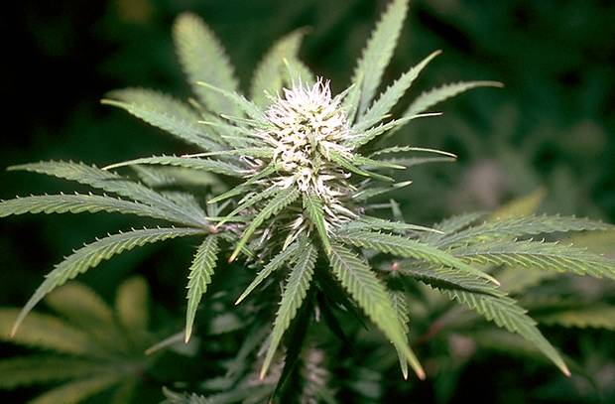
FATAL CRASH RESPONSIBILITY OF DRIVERS USING ALCOHOL & MARIJUANA
Drugs
Increased Odds of Fatal Crash Responsibility *
Alcohol >.05
5.7
Marijuana
3.0
Alcohol & Marijuana
19.0
* Compared to sober risk of responsibility
46

Slide 49
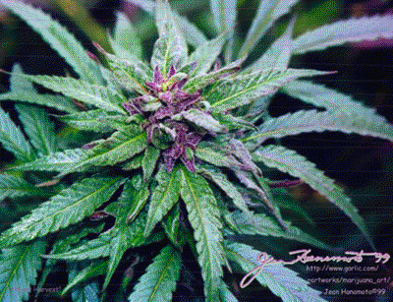
MARIJUANA’S EFFECTS ON ABILITIES RELATED TO DRIVING
Skills related to driving performance are impaired as THC blood level increases
Marijuana affects driver’s attentiveness, perception of time and speed, and ability to draw on past driving experiences
Impairment increases when marijuana is combined with alcohol
47

Slide 50
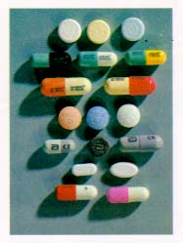
EFFECTS OF DOWNERS ON ABILITIES RELATED TO DRIVING
Downers include benzodiazepines (Xanax, Valium), sedatives (Ambien), tranquilizers, and barbiturates
Slower reaction time, reduced vigilance, impaired attention tasks and cognition
Level of risk varies with type of downer and how long driver has been using it (risk greater when first start using)
Valium produces significant driving impairment over multiple doses.
Crash risk is 1.6 to 5 times that of driver with no drugs
48

Slide 51
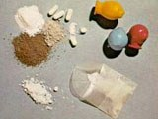
EFFECTS OF OPIATES ON ABILITIES RELATED TO DRIVING
Opioids (heroin, Vicodin, OxyContin, morphine, codeine) produce mental clouding, calmness, and drowsiness
Effects include slow driving, weaving, poor vehicle control, slow response to stimuli, falling asleep
Impairment varies by type of opioid used, route of administration, and tolerance
49

Slide 52
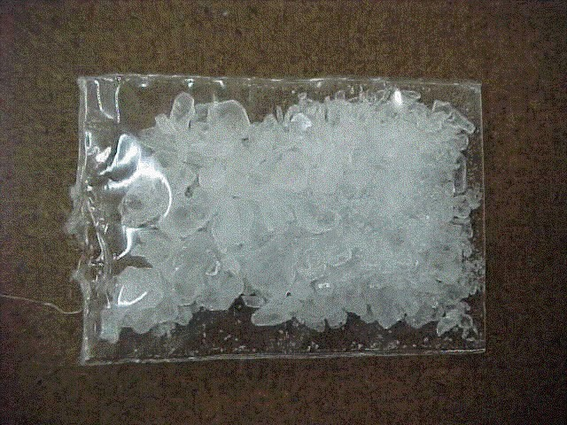
EFFECTS OF STIMULANTS ON ABILITIES RELATED TO DRIVING
Stimulants include cocaine, MDMA, methamphetamine, Adderall
Cocaine associated with speeding, losing vehicle control, high-risk behaviors, aggressive driving, inattentive driving
Low doses may enhance alertness, but prolonged use results in sleep deprivation, paranoia, aggression
Some evidence of psychomotor and cognitive impairment in attention, perception and memory with MDMA use
50

Slide 54
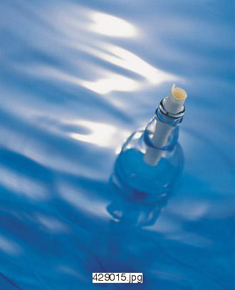
ALCOHOLISM
More/less alcohol needed for desired effect
Withdrawal symptoms or drink to avoid withdrawal
Desire or unsuccessful efforts to cut down
Drinking larger amounts or for longer period than planned
Activities reduced/given up because of drinking
Much time spent to obtain, use, or recover
Continued use despite problems
Any three reveal alcoholism.
51

Slide 55
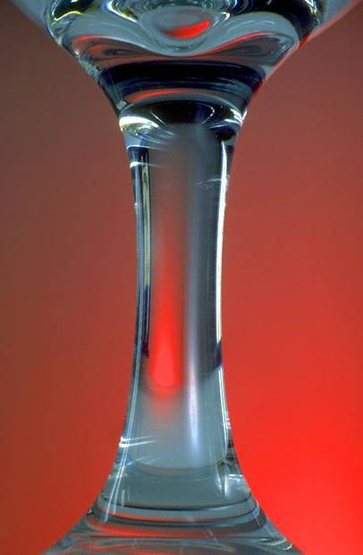
SUBSTANCE ABUSE
Has using alcohol or drugs in the last year...
Contributed to difficulty/inability to meet home, school, or work responsibilities?
Put self in physical danger (driving, sports activities, etc.)?
Led to problems with the legal system?
Led to problems with others (friends, family, fights, etc.)?
Any one YES answer reveals abuse.
52

Slide 56




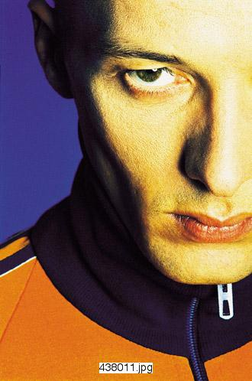
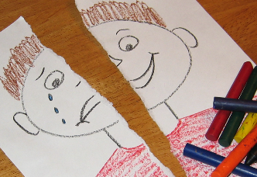

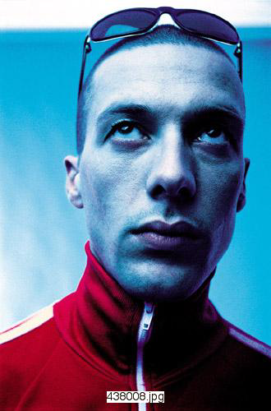


SIGNS OF ALCOHOLISM
Increase in tolerance
Craving alcohol
Drinking to cope
Preoccupation with drinking
Personality change
Feelings of remorse, guilt, shame, self-hatred
Blackouts
?
?
?
?
RATIONAL
LIES
Rationalization
Blaming others
53

Slide 57








SIGNS OF ALCOHOLISM
Denial
Hiding/protecting source
Gulping/sneaking drinks
Work problems
Money problems
Physical problems
Binge drinking
Delirium tremens (DT’s)
54

Slide 58







OTHER SIGNS OF ALCOHOLISM
Difficulty in sleeping
Loss of sexual potency
“Telephonitis”
“Not that bad yet”
Changing jobs
Drinking alone
Opinion of AA/NA
55

Slide 59





OTHER SIGNS OF ALCOHOLISM
DWI-PI-MIP arrests
Different behavior after drinking
Family history
Leisure activities focus on alcohol
Heavy smoking
Age at which drinking began
Use of other drugs
56

Slide 60
NUMERICAL DRINKING PROFILE (NDP)
SCORE
INDICATION
1
No Problem
2 - 5
Potential Problem
6 - 7
Evident Problem
57

Slide 62



ACCIDENT FACTORS
Time of day
Woman’s drinking
Child’s inattention
Attention to girlfriend
DRIVER’S DRINKING
No seatbelts
58

Slide 63


PERSONAL ACTION
Regulate Drinking
None
Separate from driving
Monitor & control amount
Improve Relationships
Use Public Transportation
Avoid Situations
Substitute Other Activities
59

Slide 64
Texas DWI Education Program
Texas Department of License and Regulation
60

